Slide 1
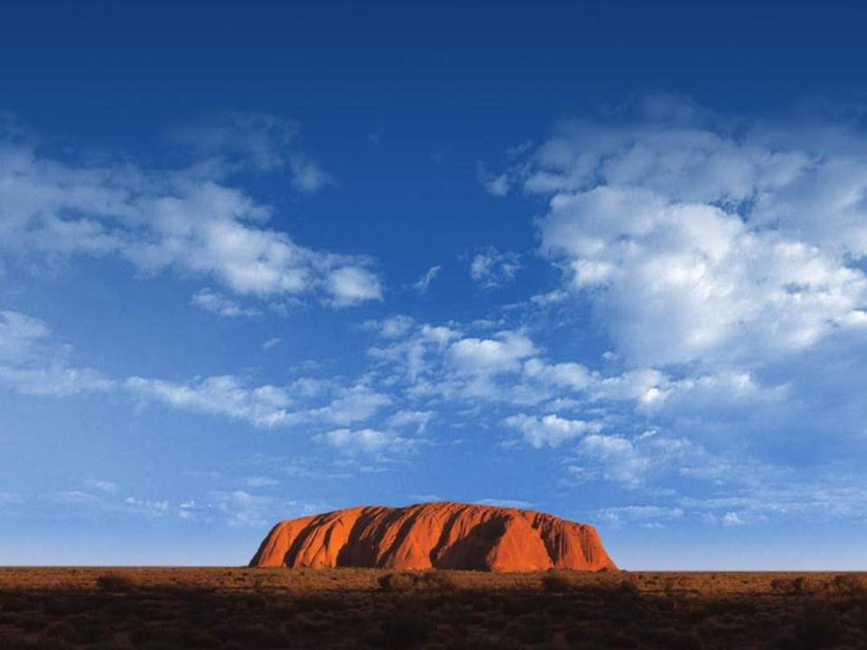
COMPANY PROFILE

Slide 2
LOCATION
LOCATED IN UDINE - NORTH EAST OF ITALY
NEAR THE AUSTRIAN AND SLOVENIAN BORDERS
ALMOST ALL EUROPEAN COUNTRIES WITHIN 1100 KM

Slide 3
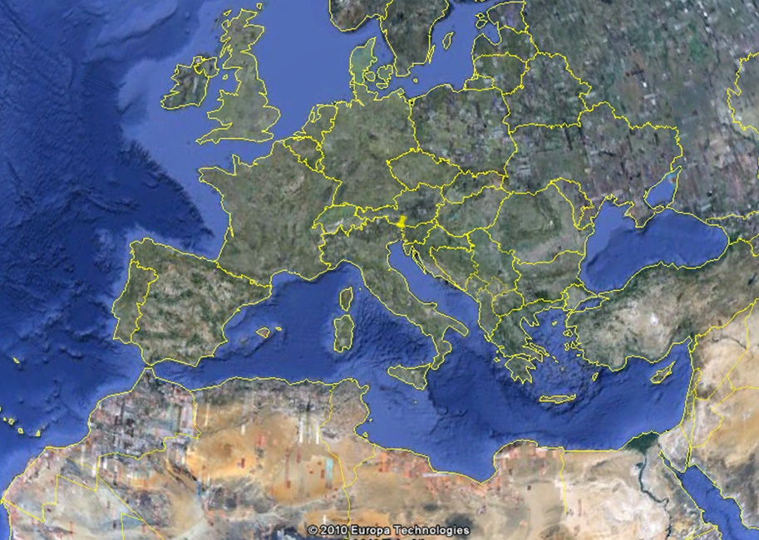
LOCATION

Slide 4
BUILDING INFRASTRUCTURE
3 SERVER ROOMS WITH A TOTAL OF 1100 MQ
2 POWER ROOMS / EACH ONE WITH REDUNDANT UPS SYSTEM AND STATIC TRANSFER SWITCH
3 EMERGENCY GENERATORS FOR A TOTAL OF 2.5 MWATT
REDUNDANT COOLING SYSTEMS & FREE COOLING
ADVANCED SECURITY SYSTEMS, TVCC AND FIRE ALARM SYSTEM

Slide 5
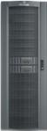
BUILDING INFRASTRUCTURE
MANAGEMENT & MONITORING
POWER STATION A
UPS 1
EMERGENCY GENERATOR
UPS 2
RETELIT
STS
INTEROUTE
EMERGENCY GENERATOR
FASTWEB
POWER STATION B
STS
EMERGENCY GENERATOR
UPS 1
UPS 2
FREE
COOLING
HVAC
HVAC
HVAC
HVAC
HVAC
HVAC
HVAC
HVAC

Slide 6









NETWORK INFRASTRUCTURE
4 FIBER OPTIC RINGS CONNECT INASSET TO PUBLIC NETWORKS
9 NATIONAL AND INTERNATIONAL CARRIERS ARE CONNECTED TO INASSET
MOST OF THEM USE INASSET FOR CO-LOCATION OF THEIR OWN EQUIPMENT

Slide 7
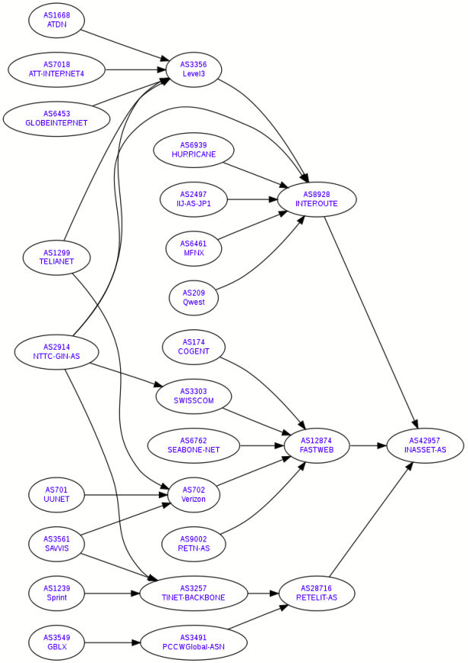
AUTONOMOUS SYSTEM – INTERNET BANDWIDTH
1Gbps - Retelit
1Gbps - Interoute Comm.
1Gbps - FastWeb

Slide 8
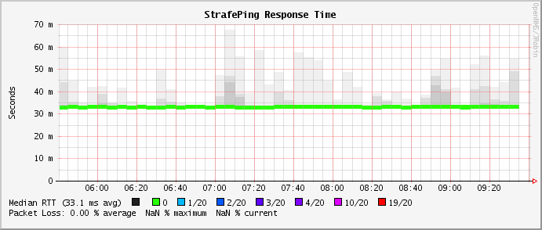
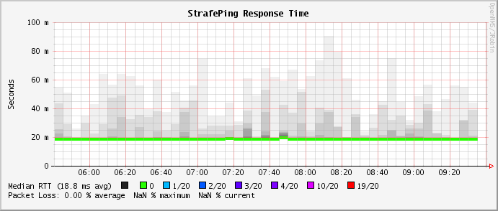
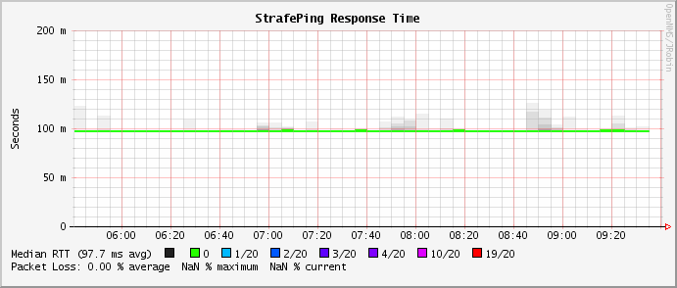
NETWORK PERFORMANCE
ITALY
EUROPE
USA

Slide 9
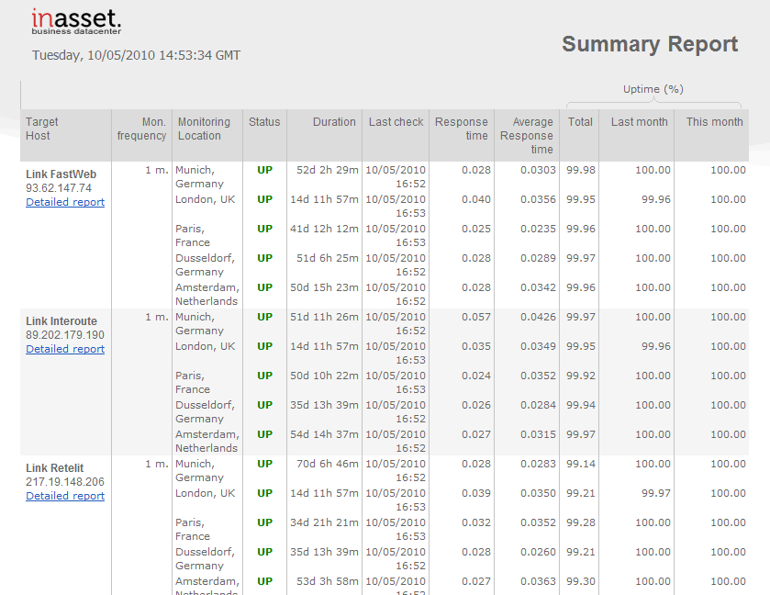
INASSET RESILIENCE
NETWORK SLA IS CERTIFIED BY INDIPENDENT COMPANY: WEBSITE PULSE
http://www.mywebreports.net/inasset_network.html

Slide 10
CERTIFICATIONS
TIER III (Data Center TIA-942)
Certified ISO/IEC 27001:2005
ISO/IEC 20000 (4Q 2011) Certification in Progress
IBM COMPLIANT
BRITISH TELECOM AND FASTWEB COMPLIANT
RIPE/LIR MEMBER
EURO-IX (Internet eXchange) MEMBER

Slide 11
GREEN
DATA CENTER IS BUILT FOLLOWING ENERGY SAVING REQUIREMENTS
FREE COOLING OVER 7000 HOURS PER YEAR
ADIABATIC FREE COOLING UPGRADE PROJECT (2011)

Slide 12
SERVICES
HOSTING
HOUSING
COLOCATION - CAGING
BUSINESS CONTINUITY
DISASTER RECOVERY
CLOUD COMPUTING
INTERNET EXCHANGE

Slide 13
FACILITIES
MAIL
COLLABORATION SUITE (SaaS)
ANTISPAM AND ANTIVIRUS GATEWAY
BACKUP INFRASTRUCTURE & REMOTE BACKUP
SHARED FIREWALL, IDS & IPS
MONITORING
TECHNICAL SUPPORT

